Slide 1
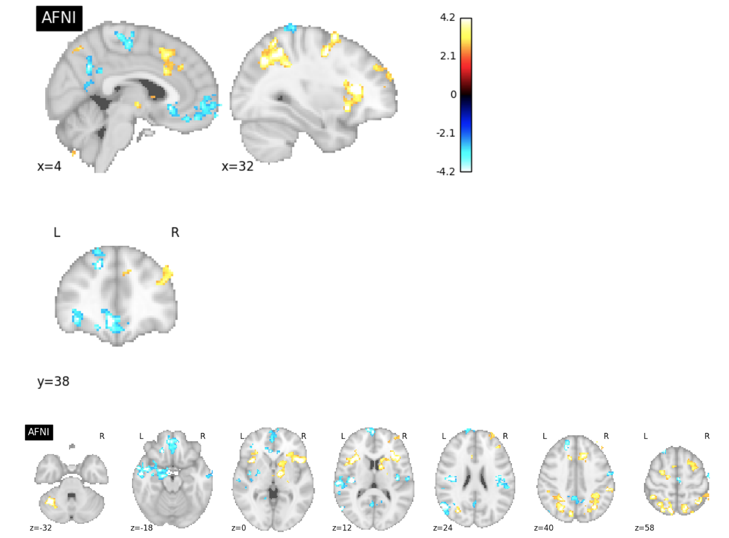
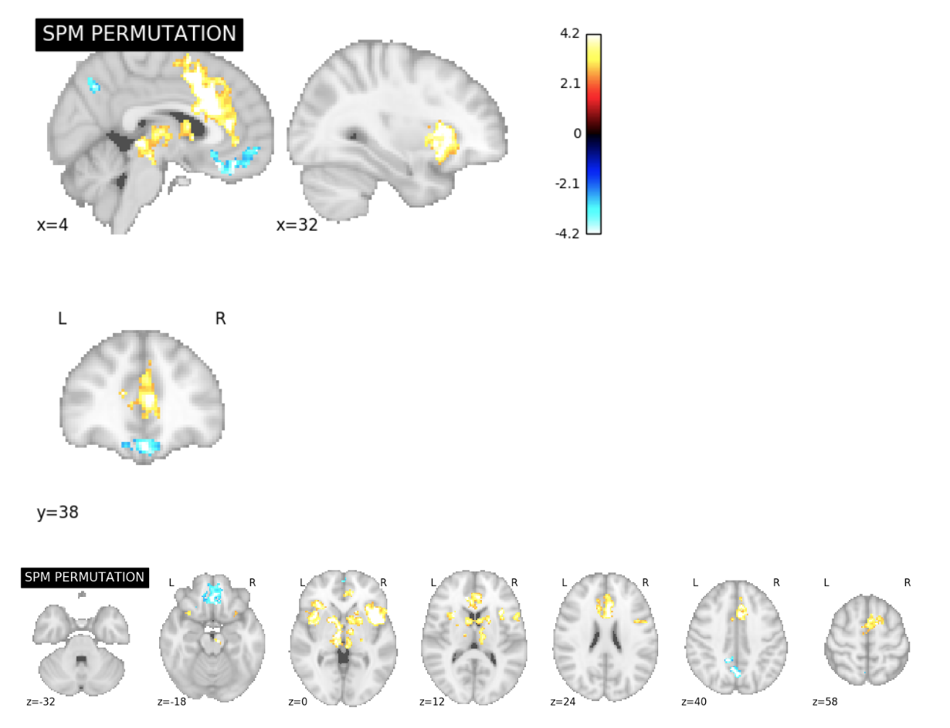
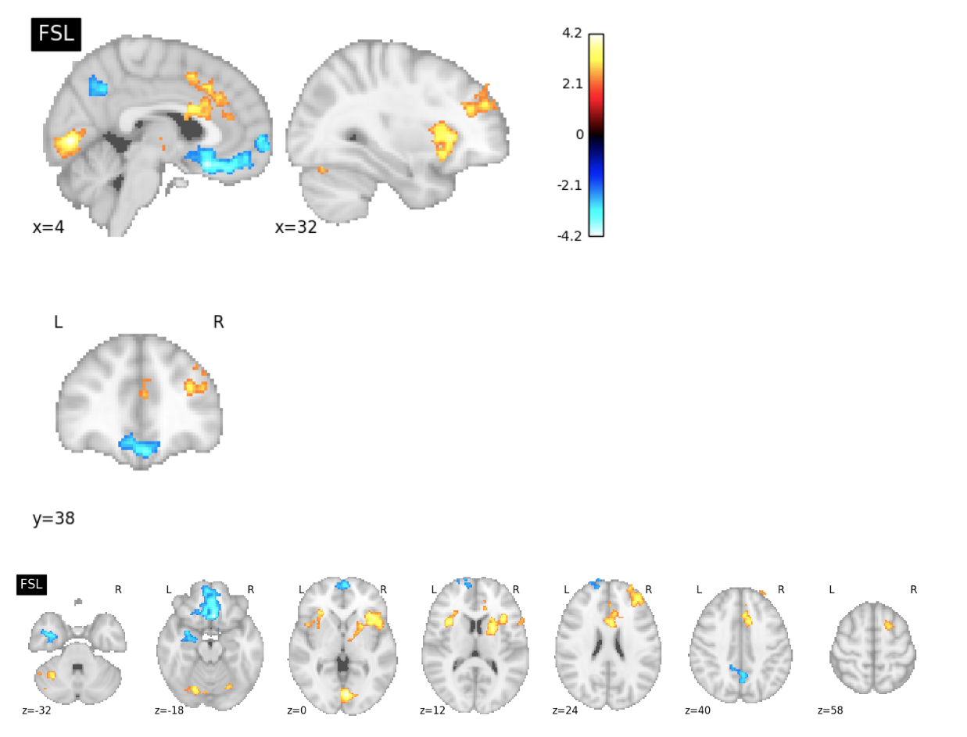
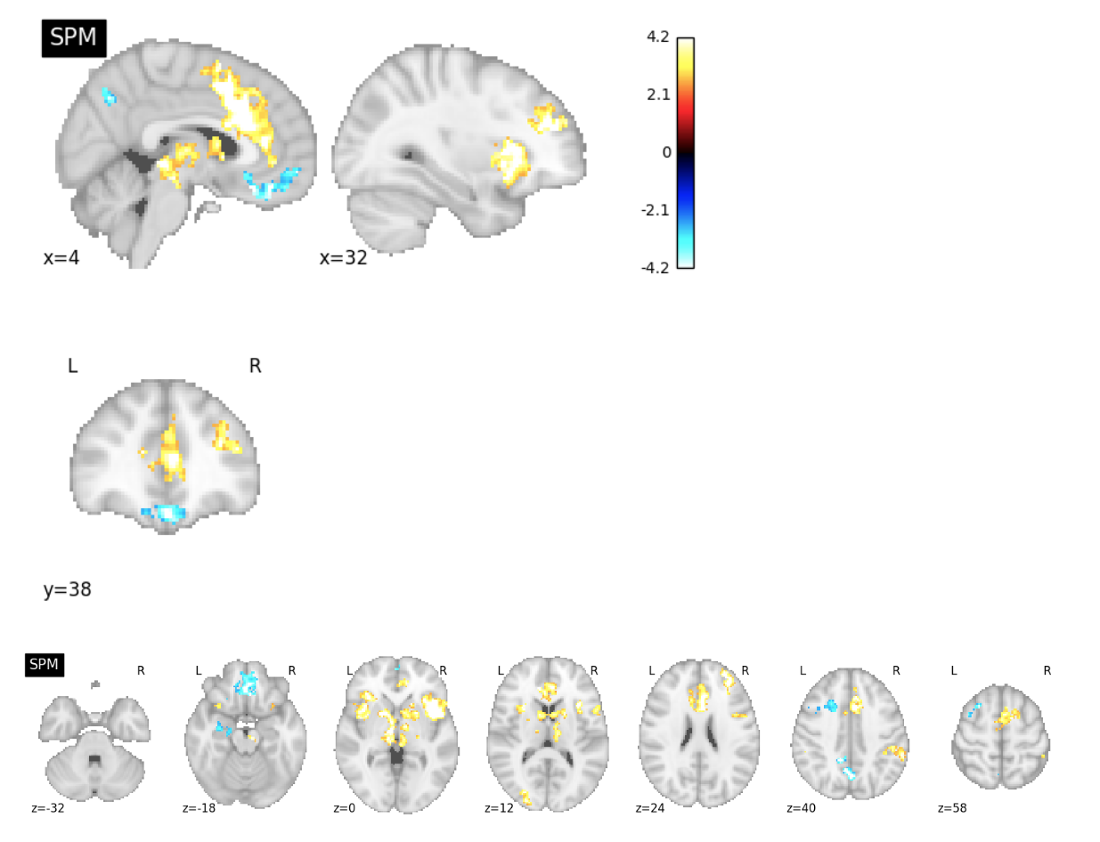
Software Comparison Figures
ds001 Reproduction Excursion Set Map Slice Comparisons

Slide 2
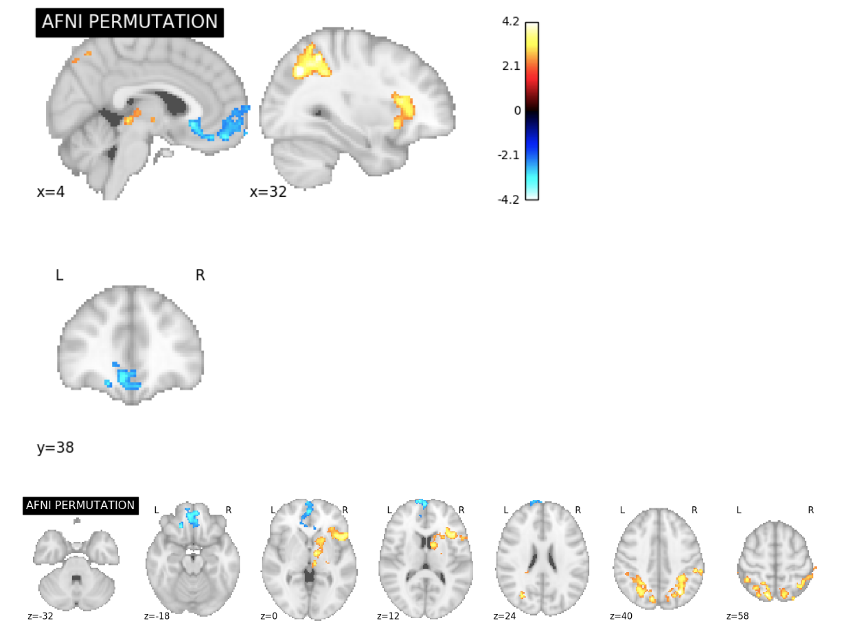
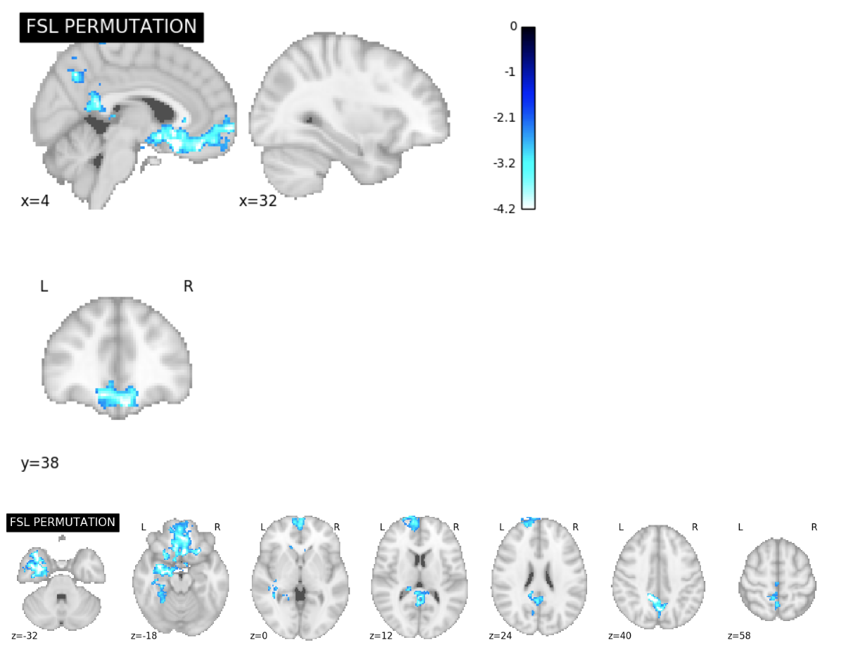
ds001 Permutation Test Excursion Set Map Slice Comparisons

Slide 3
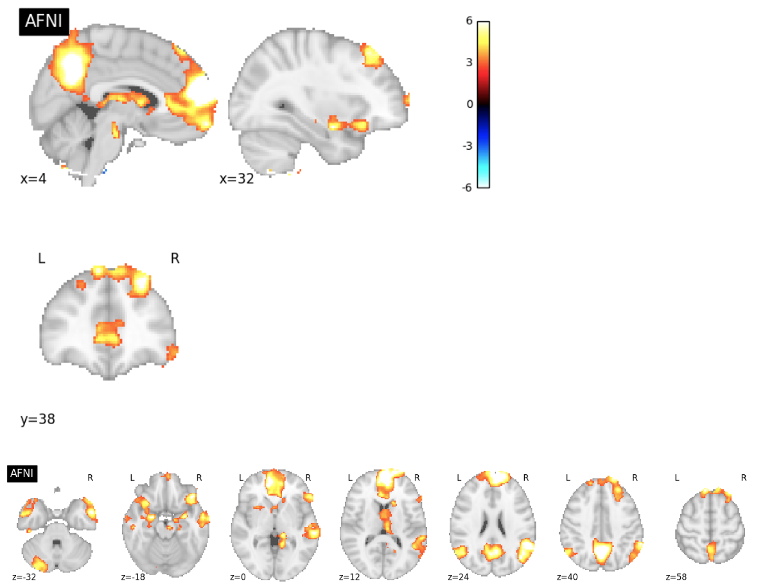
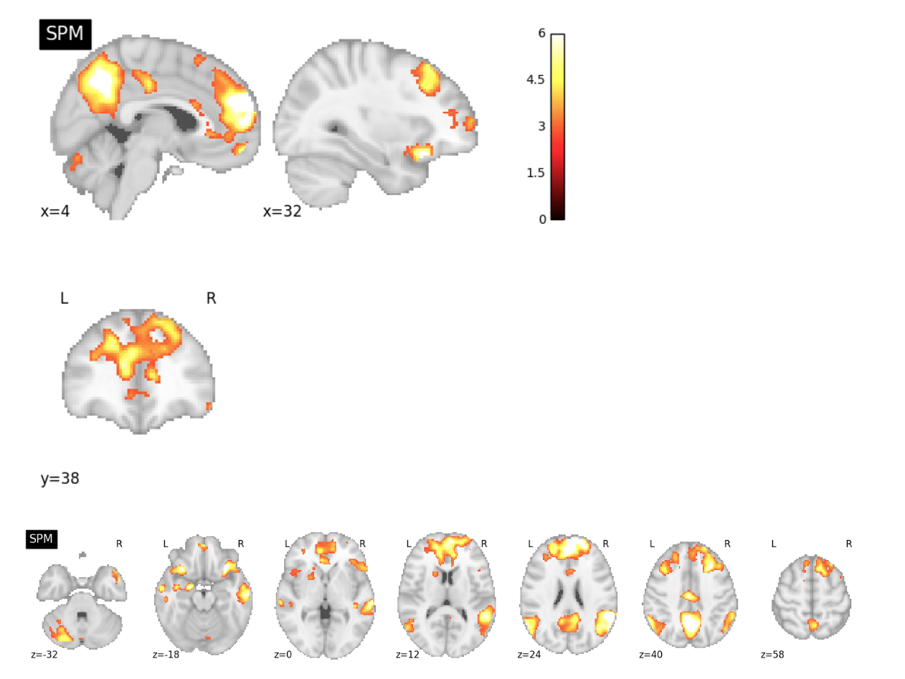
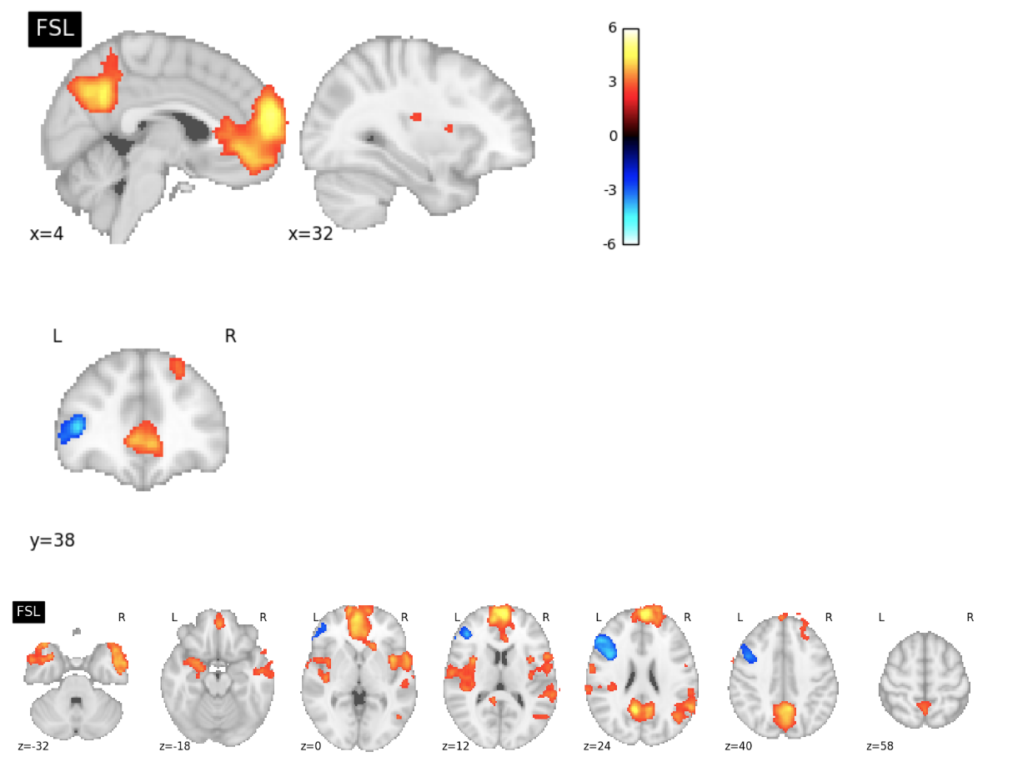
ds109 Reproduction Excursion Set Map Slice Comparisons

Slide 4
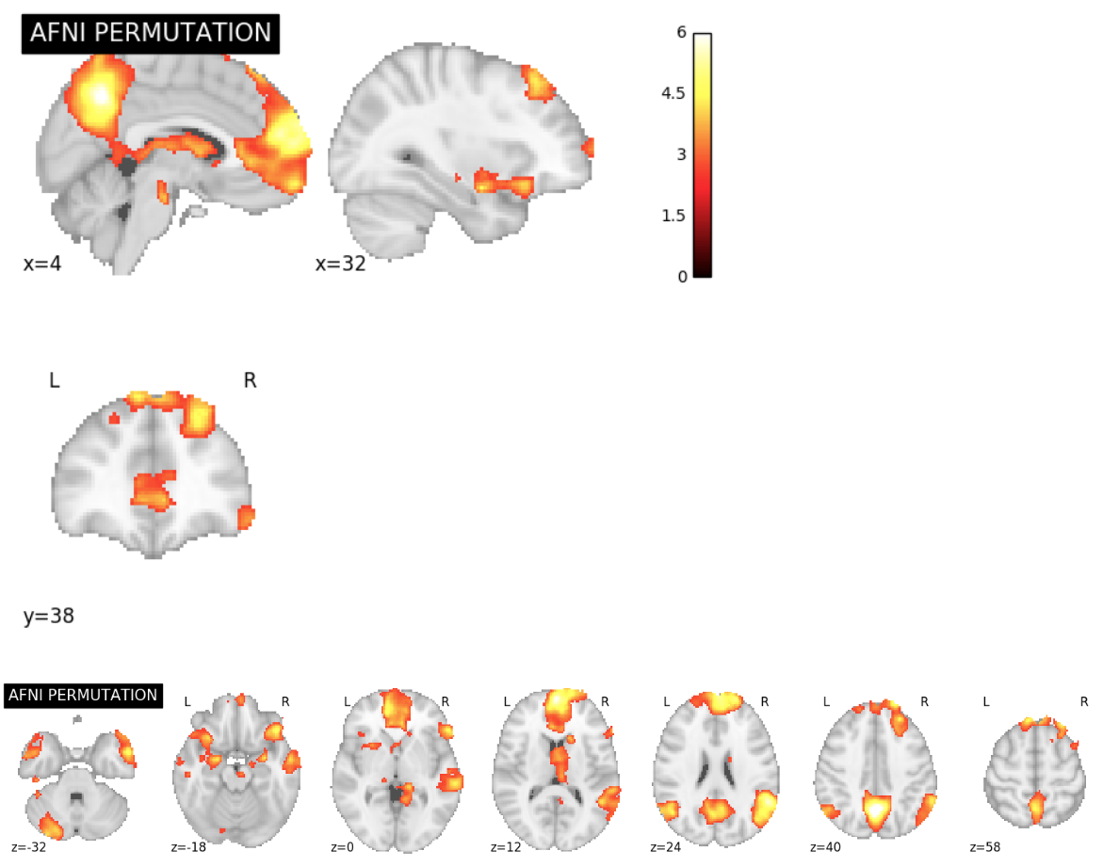
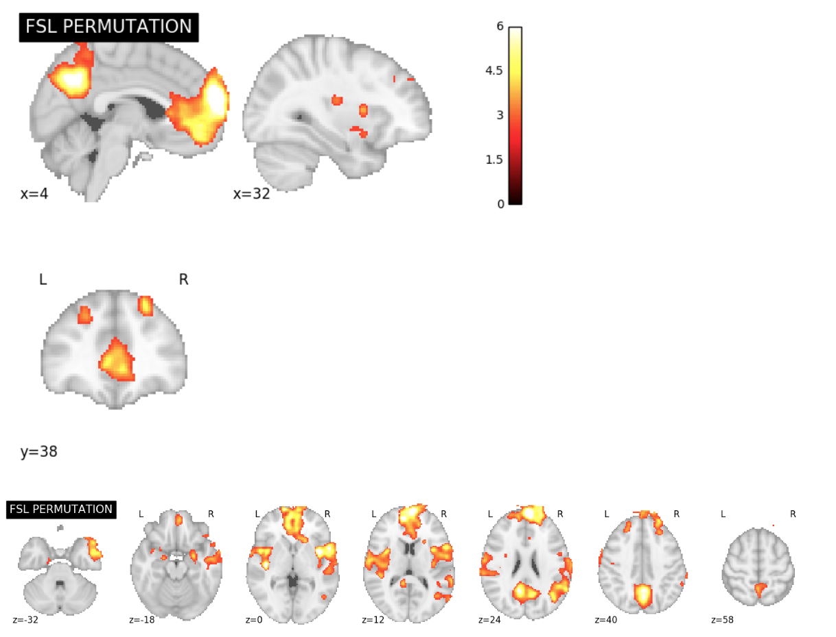
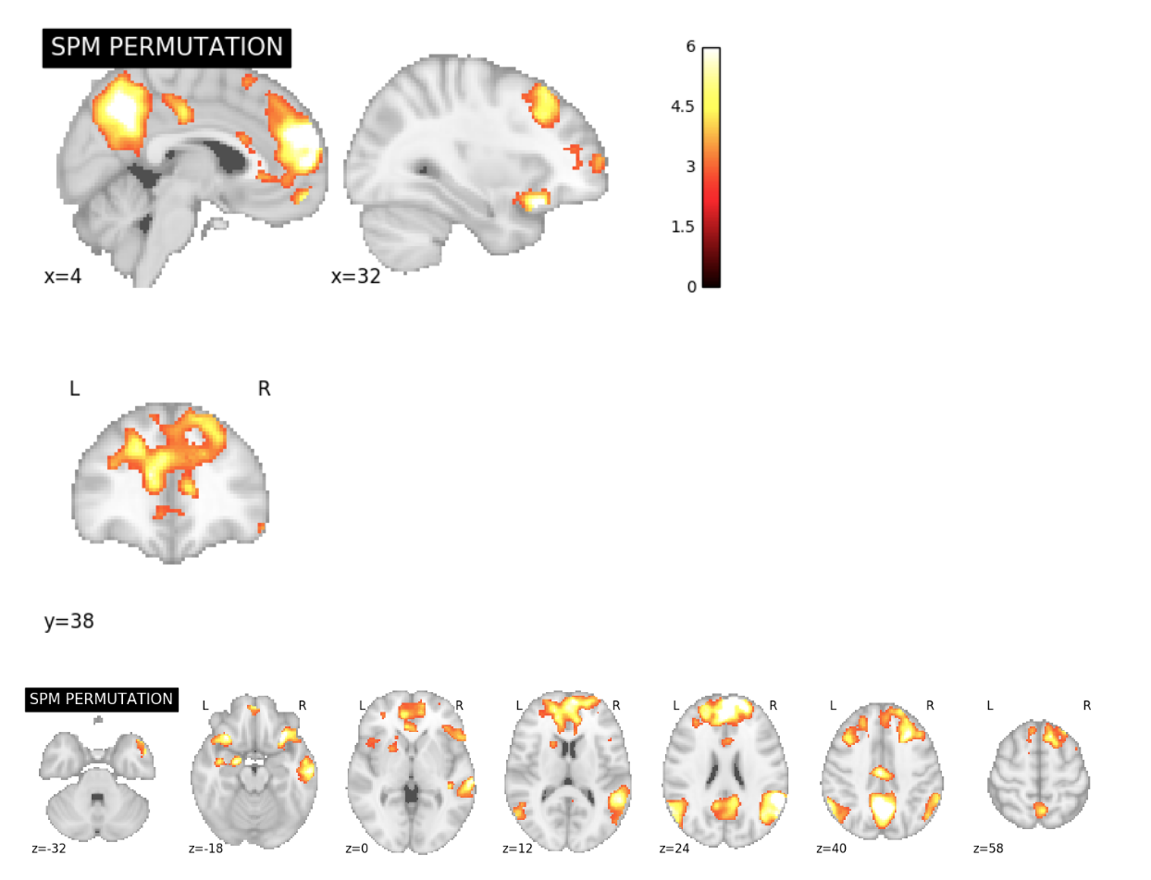
ds109 Permutation Test Excursion Set Map Slice Comparisons

Slide 5
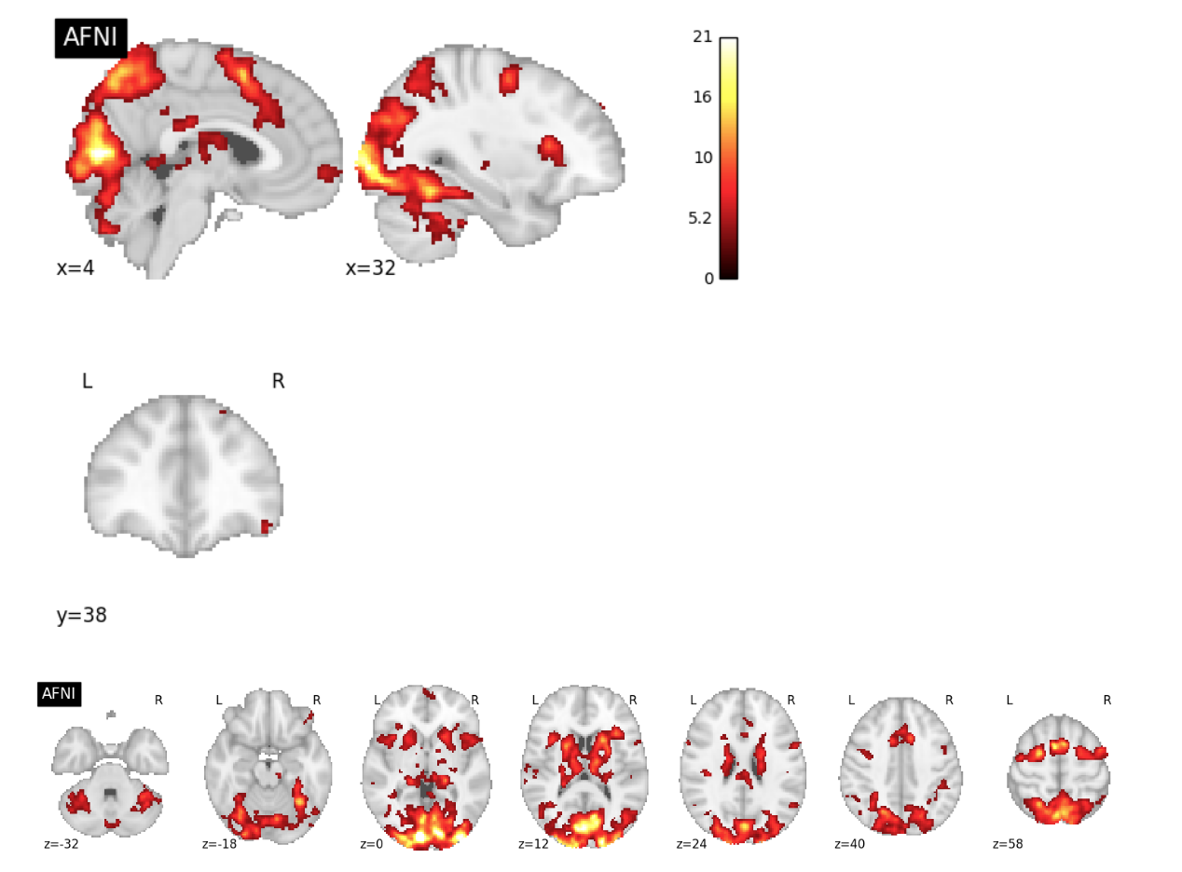
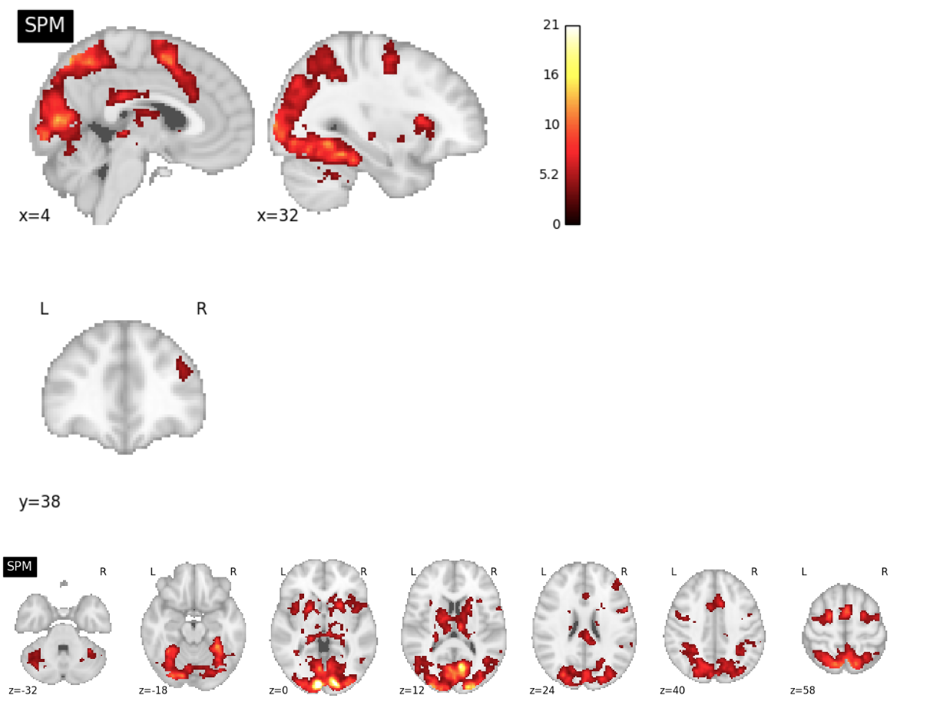
ds120 Reproduction Excursion Set Map Slice Comparisons

Slide 6
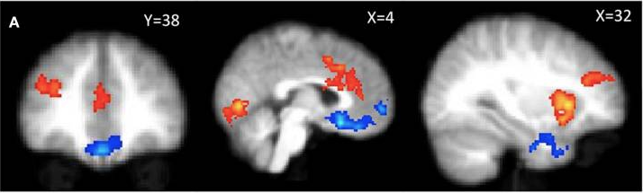
ds001 Publication Figure Reproduction
PUBLICATION
4.2
-2.3
2.3
-4.2

Slide 7
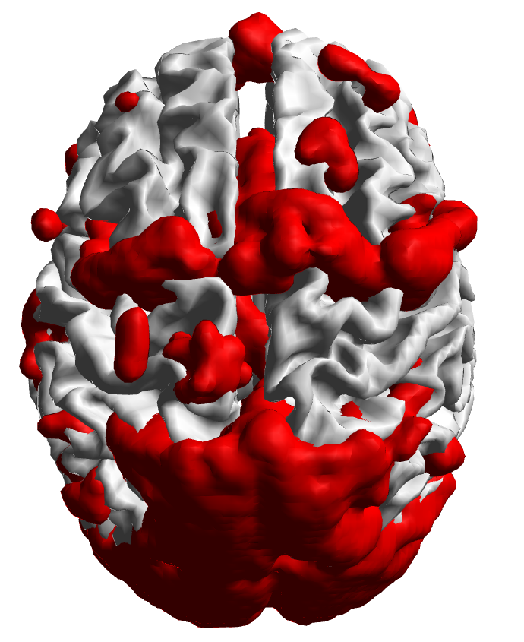
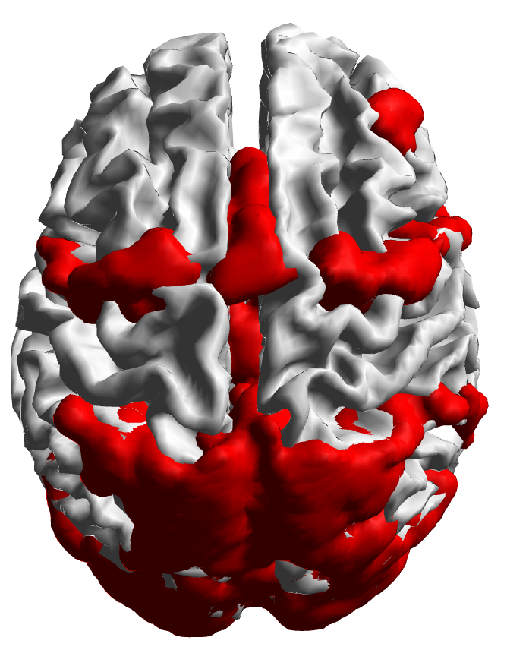
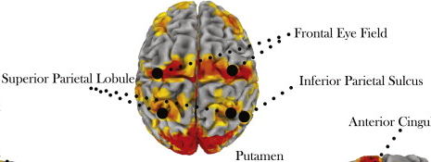
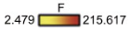
ds120 Publication Figure Reproduction
PUBLICATION

Slide 8
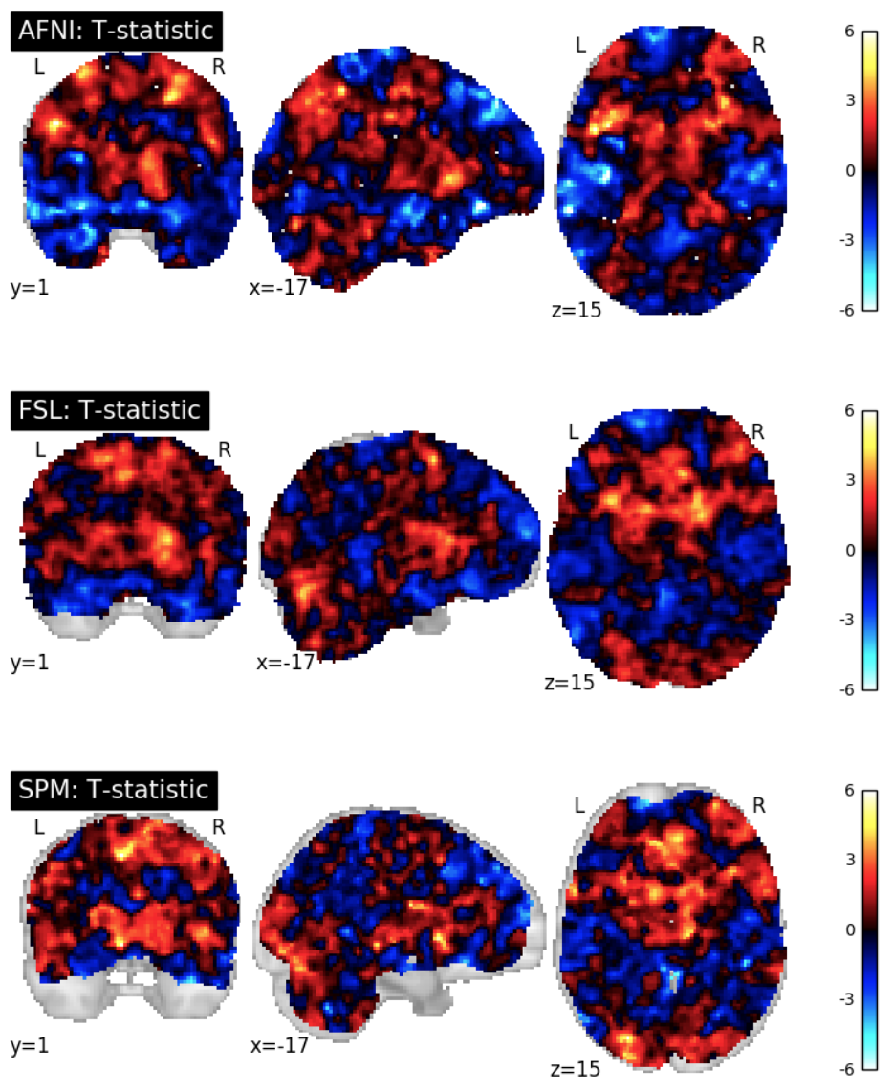
ds001 Reproduction T-Statistic Map Slice Comparisons

Slide 9
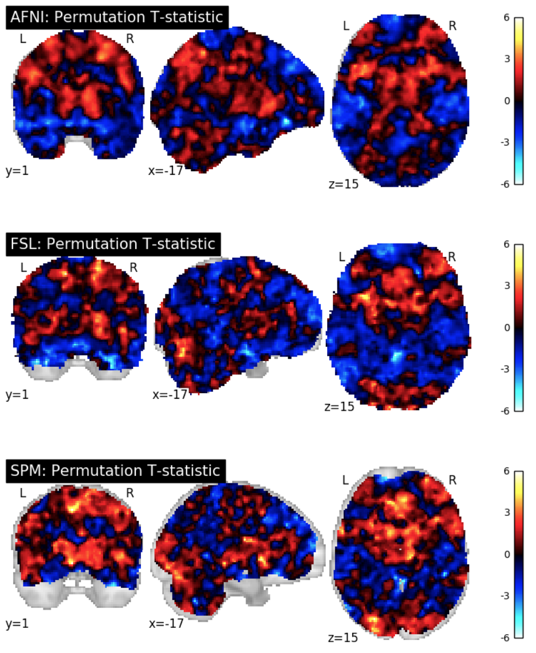
ds001 Permutation Test T-Statistic Map Slice Comparisons

Slide 10
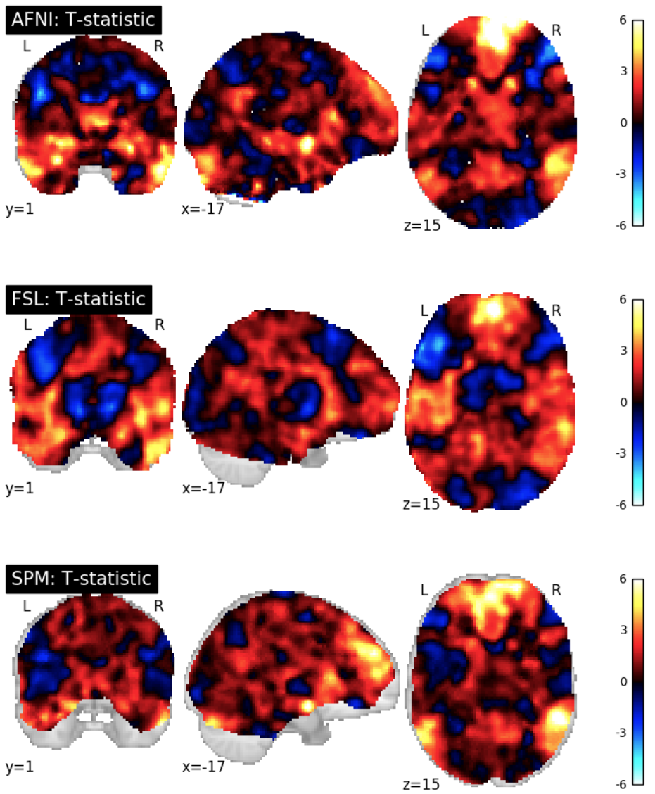
ds109 Reproduction T-Statistic Map Slice Comparisons

Slide 11
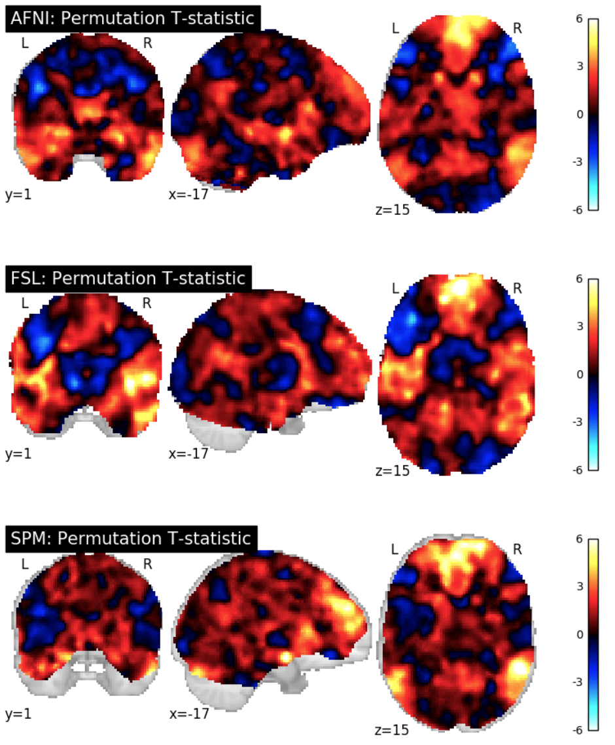
ds109 Permutation Test T-Statistic Map Slice Comparisons

Slide 12
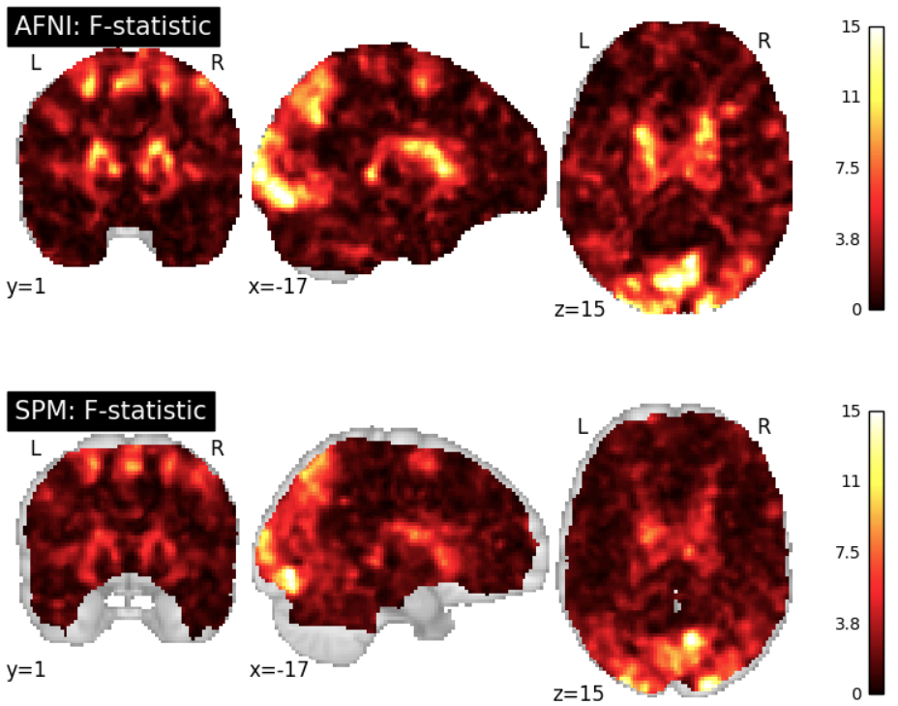
ds120 Reproduction F-Statistic Map Slice Comparisons

Slide 13
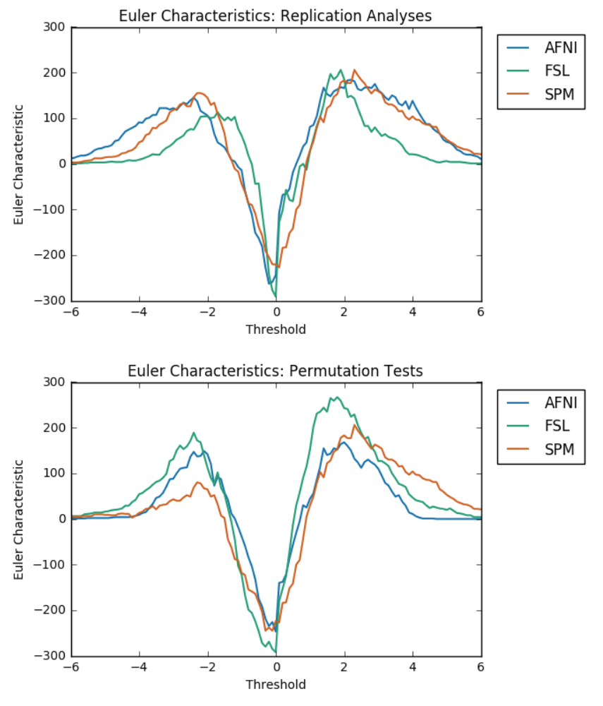
ds001 Euler Characteristics

Slide 14
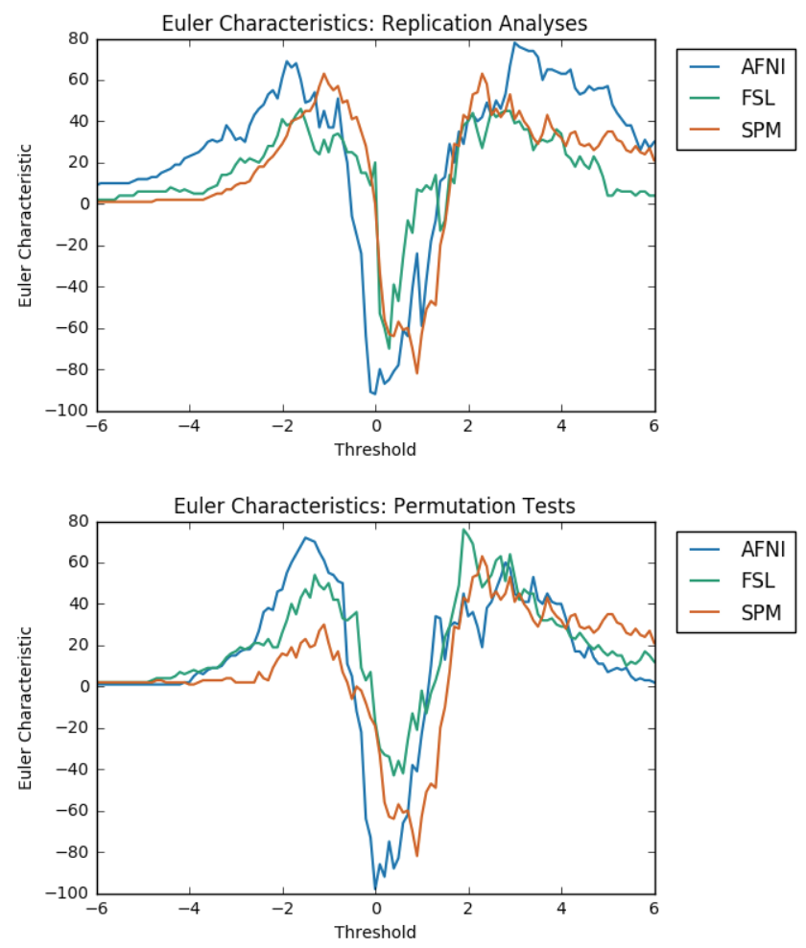
ds109 Euler Characteristics

Slide 15
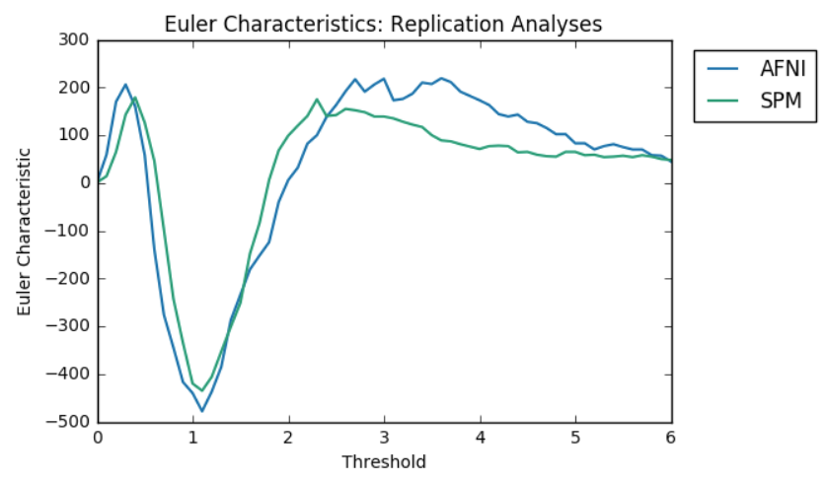
ds120 Euler Characteristics

Slide 16
Euler Characteristics
ds001
ds109
Reproduction Analyses
Permutation Test Analyses

Slide 17
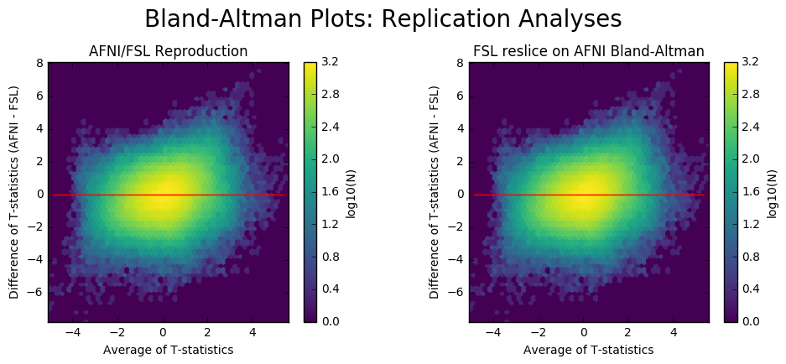
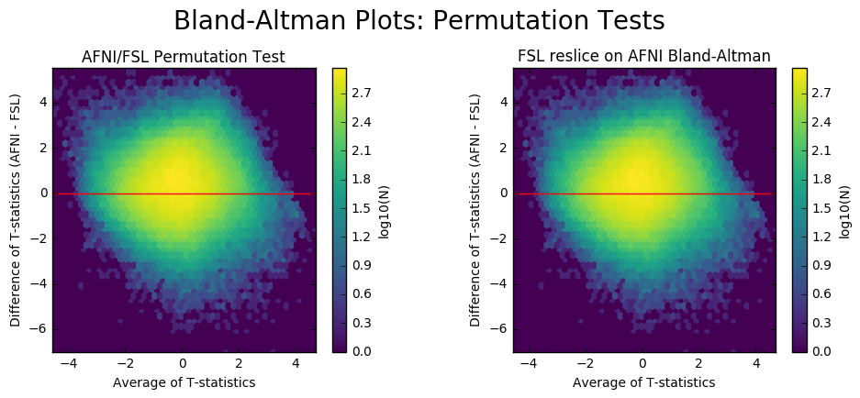
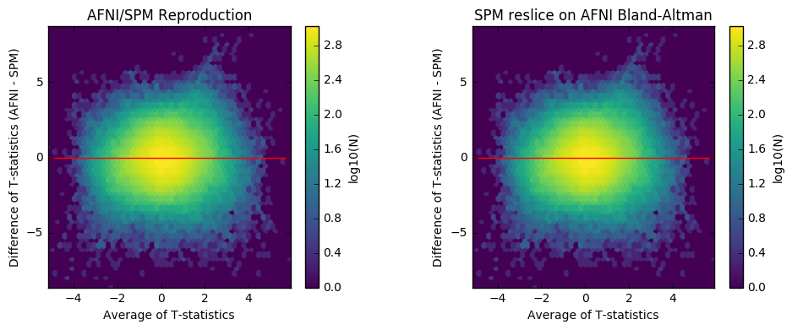
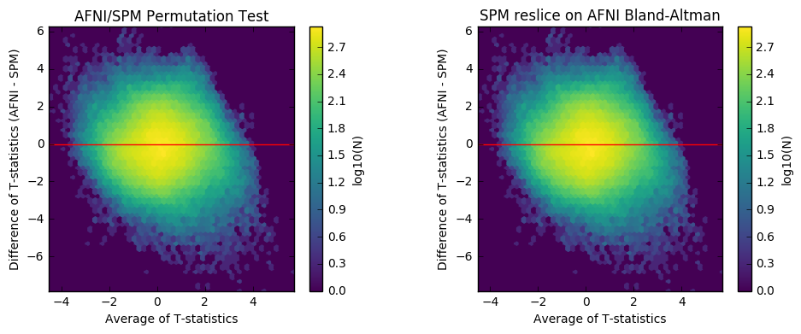
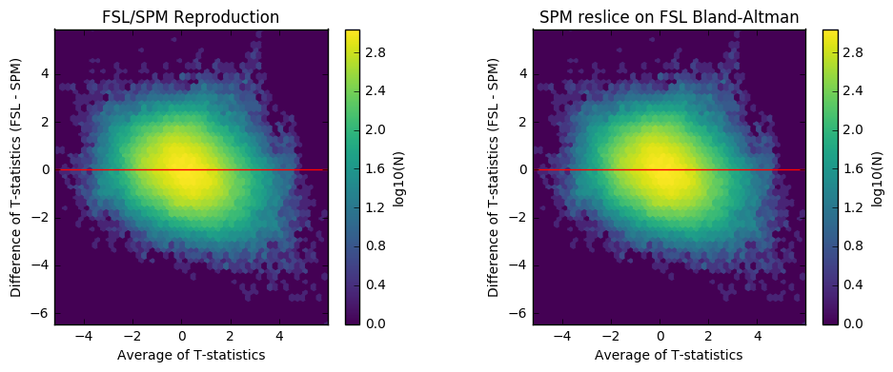
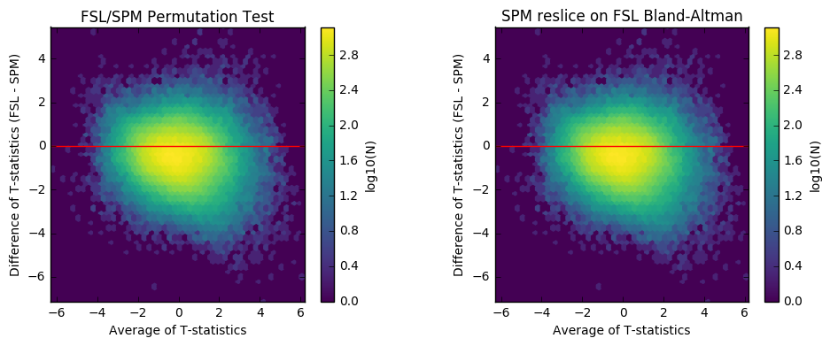
Bland-Altman Plots: ds001
Reproduction Analyses
Permutation Tests

Slide 18
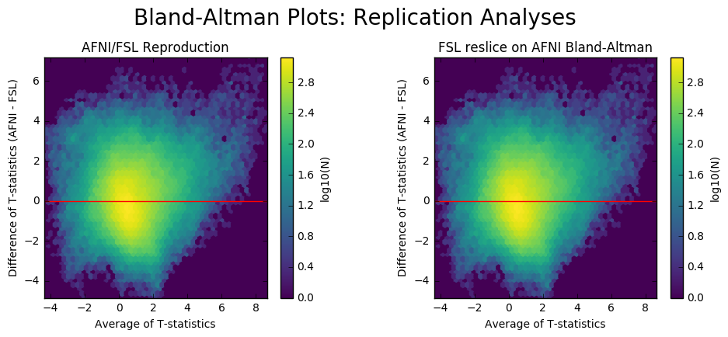
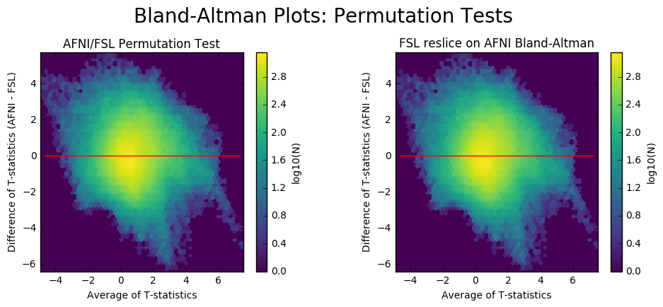
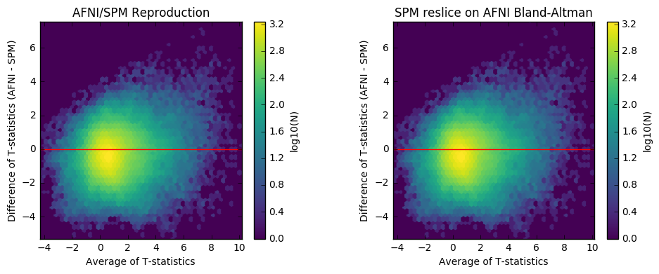
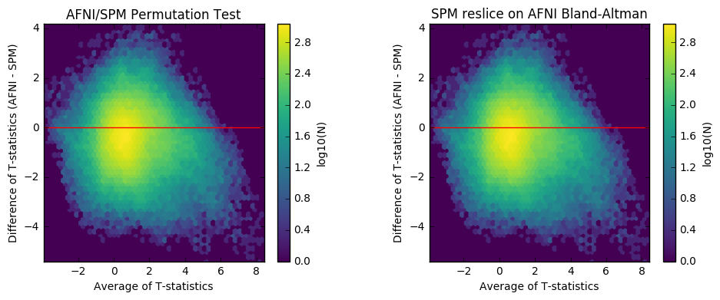
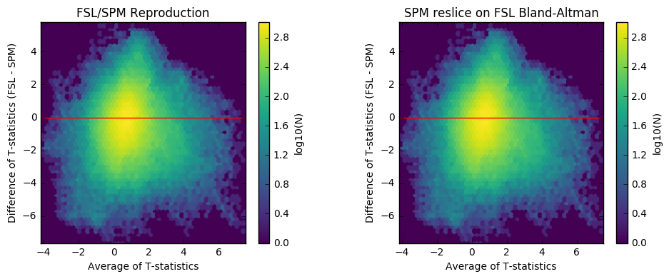
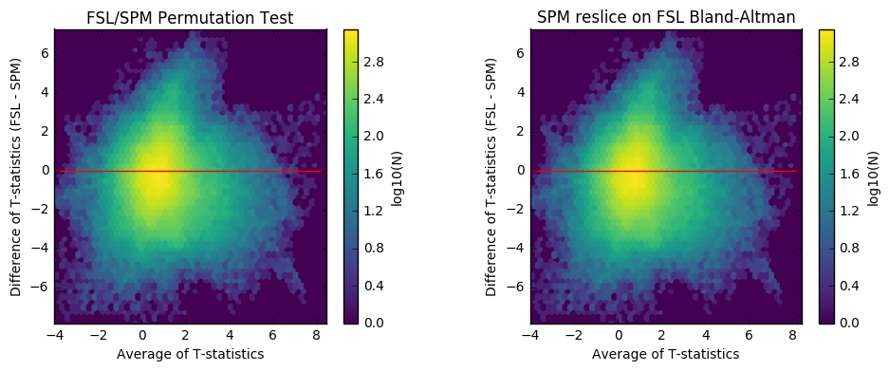
Bland-Altman Plots: ds109
Reproduction Analyses
Permutation Tests

Slide 19
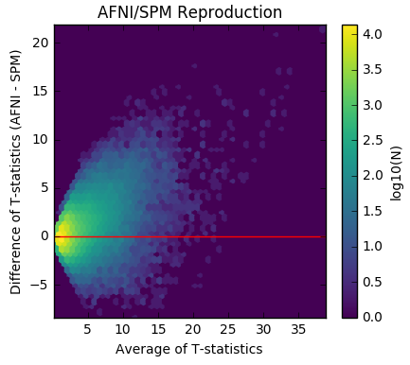
Bland-Altman Plots: Reproduction Analyses
ds001
ds109
ds120

Slide 20
Bland-Altman Plots: Permutation Tests
ds001
ds109

Slide 21
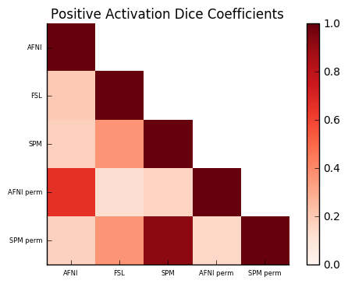
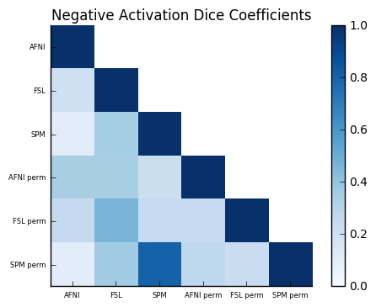
ds001 Dice Coefficients

Slide 22
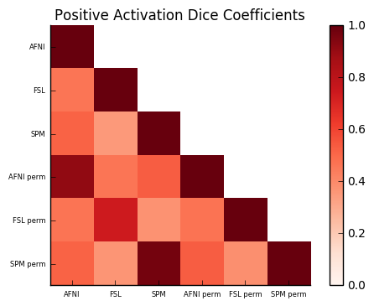
ds109 Dice Coefficients

Slide 23
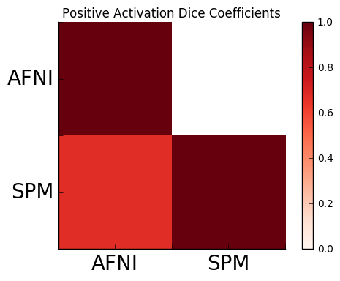
ds120 Dice Coefficients

Slide 24
Dice Coefficients
ds001
ds109
ds120

